Slide 1
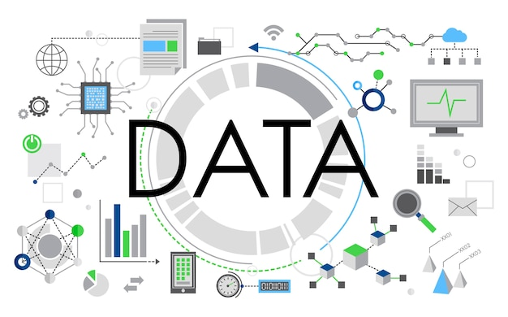
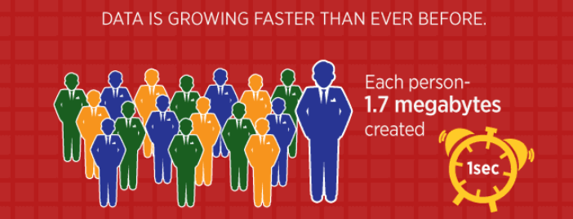
Data
Facebook users send on average 31.25 million messages and view 2.77 million videos every minute.
A massive growth in video and photo data, where every minute up to 300 hours of video are uploaded to YouTube alone.

Slide 2

Data
Quantities 1,2,3,…100,…1000…
Characters A, B, C…Z, a, b, c,…z
Symbols ! @ # $ % & * ()…
Quantities , Characters, Symbols are stored in digital format.
Data → plural Datum→ singular
Data is Every Where
Machines, Robots, Sensors, Our self are products of data.
All roads lead to DATA.

Slide 3
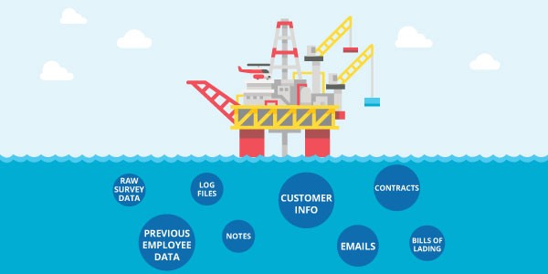
Numerous kinds of data
Text data (.doc, .txt, .pdf…)
Excel data (.csv, .tsv)
HTML data
XML data
JSON data
Relational Database (Oracle, MySql, Sqlite…)
Log files / Transactional data
Sensors/Web servers
Social Media data (FB, Twitter, WhatsApp, YouTube…)
Image / Audio / Video / Signal….

Slide 4

Data
Data is useful in a refined form.
  Data to Information
  Information to Knowledge
  (hidden knowledge/pattern/relationships/insights)
  Knowledge to Decision making
  Decision making to Result cycle.

Slide 5
Types of Data
Structured
- Information with a high degree of organization that is readily
searchable and quickly consolidate into facts
Example: RDBMS, Spreadsheets
Unstructured
- Information with a lack of structure that is time and energy consuming to
search and find and consolidate into facts
Example : email, documents, images, reports

Slide 6
Types of Data
Structured Data | Unstructured Data
Structured data is quantitative and is often displayed as numbers, dates, values, and strings. | Unstructured data is qualitative data and includes text, video, audio, images, and more.
Structured data is stored in rows and columns. | Unstructured data is stored as audio, text, and video files, or NoSQL databases.
Estimated 20% of business data. | Estimated 80% of business data
Stored in data warehouses. | Stored in applications, NoSQL databases, data lakes, and data warehouses.
Reveals patterns and trends that show you what’s happening. | Reveals patterns and trends that explain why something is happening.
Requires less storage space. | Needs more storage space.
Easy to analyze with tools like Excel. | Hard to analyze without AI tools.

Slide 7
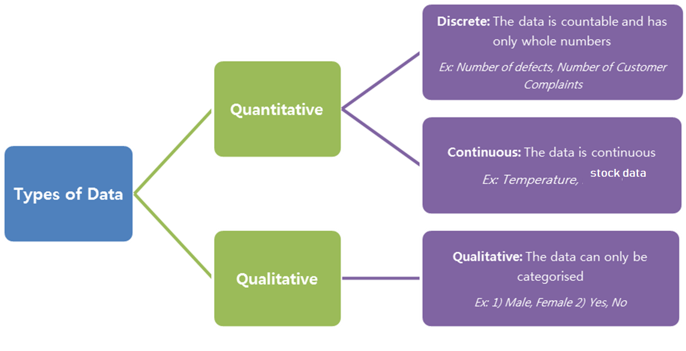
range

Slide 8

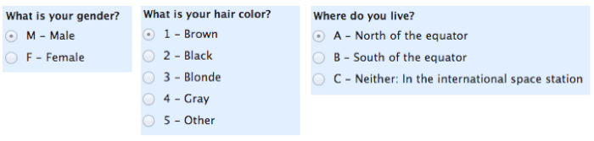
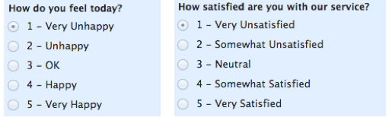
Qualitative data
Binary Data
0 or 1
Toss of a coin
Switch on/off
Nominal Data
Data is not ordered.
cannot perform any quantitative mathematical operations, such as addition or division.
Ordinal Data
Data is ordered.
Typically measures of non-numeric concepts like satisfaction, happiness, discomfort, etc.

Slide 9
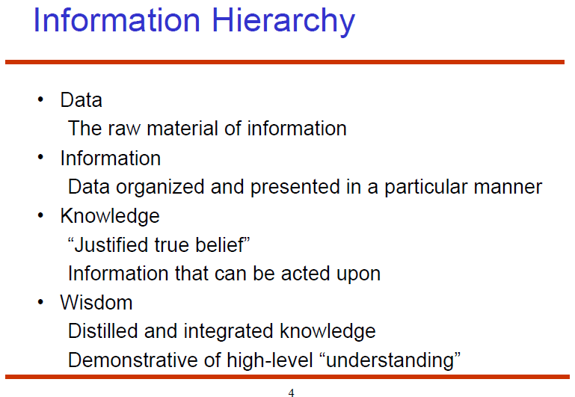
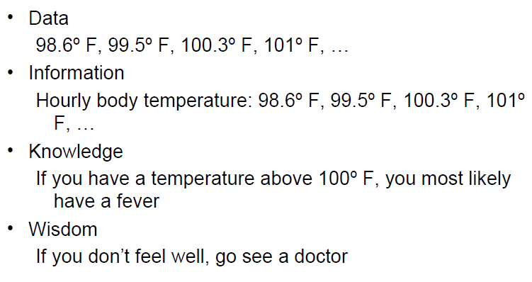

Slide 10

Students for AIML course
USA | China | USA | Sweden | China
Canada | China | Japan | Mexico | USA
China | Germany | India | India | Japan
USA | USA | USA | China | China
India | Japan | England | India | Japan
Englad | India | China | Mexico | USA
Mexico | USA | Canada | Pakistan | India
Japan | China | USA | Japan | Germany
China | India | India | China | China
Germany | Japan | China | USA | Japan
Think?

Slide 11

Students for AIML course
Country | Frequency | Proportion | Percent
Canada | 2 | 0.04 | 4
China | 12 | 0.24 | 24
England | 2 | 0.04 | 4
Germany | 3 | 0.06 | 6
India | 8 | 0.16 | 16
Japan | 8 | 0.16 | 16
Mexico | 3 | 0.06 | 6
Pakistan | 1 | 0.02 | 2
Sweden | 1 | 0.02 | 2
USA | 10 | 0.2 | 20
Total | 50 | 1 | 100
Analyze?

Slide 12

Students for a AIML course
Continent | Frequency | Relative Frequency
North America | 15 | 30%
Asia | 29 | 58%
Europe | 6 | 12%
Interpret ?

Slide 13
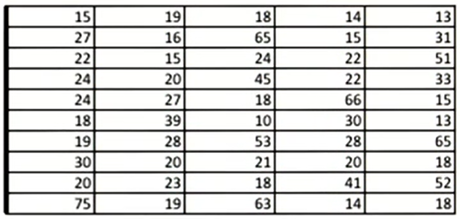
Sample Student Ages
Think?

Slide 14
Sample Student Ages
Age | Frequency
0-19 | 19
20-39 | 21
40-59 | 5
60-79 | 5
Analyze?

Slide 15

Sample Student Ages
Interpret ?

